Slide 1
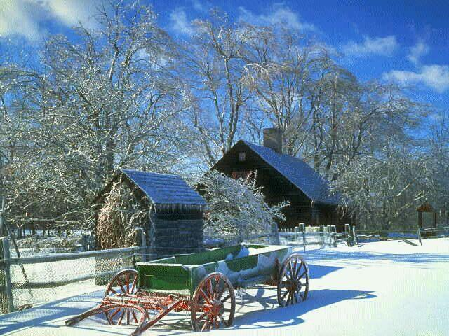

If you have food in the refrigerator, clothes on your back, a roof overhead and a place to sleep ...
You are richer than 75% of this world.
www.richardtong.com.au

Slide 2
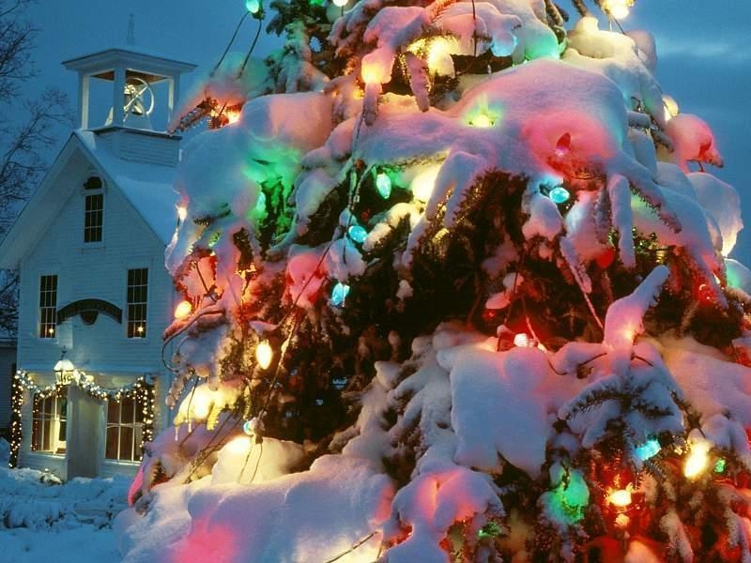
If you have money in the bank, in your wallet, and spare change in a dish some place ...
You are among the top 8% of the world's wealthy.
www.richardtong.com.au

Slide 3
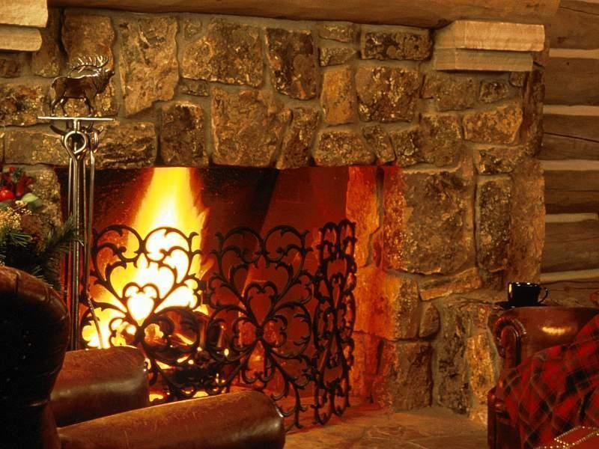
If you woke up this morning with more health than illness ...
You are more blessed than the million who will not survive this week.
www.richardtong.com.au

Slide 4
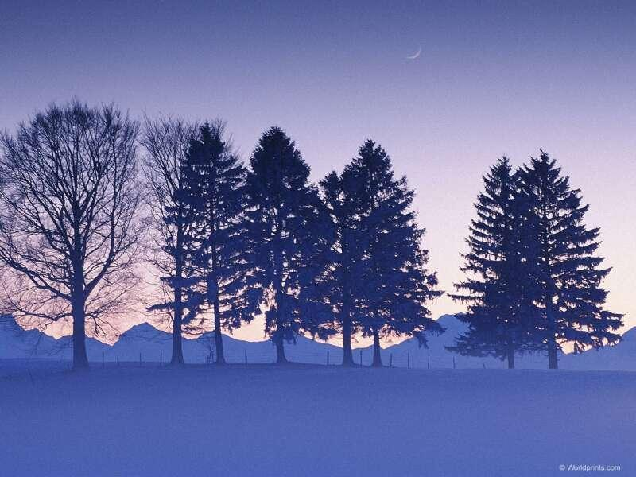
If you have never experienced the danger of battle, the loneliness of imprisonment, the agony of torture, or the pangs of starvation...
You are ahead of 500 million people in the world.
www.richardtong.com.au

Slide 5
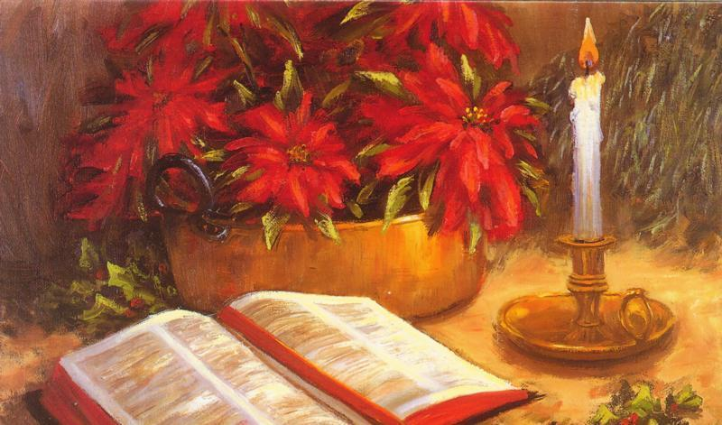
If you can attend a church meeting without fear of harassment, arrest, torture, or death ...
You are more blessed than three billion people in the world.
www.richardtong.com.au

Slide 6
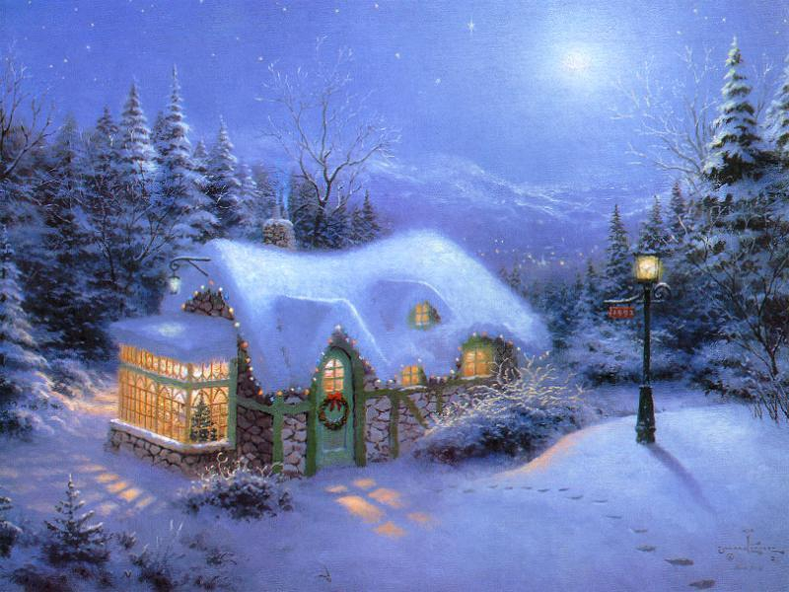
If your parents are still alive and still married ...
You are very rare, even in the United States.
www.richardtong.com.au

Slide 7
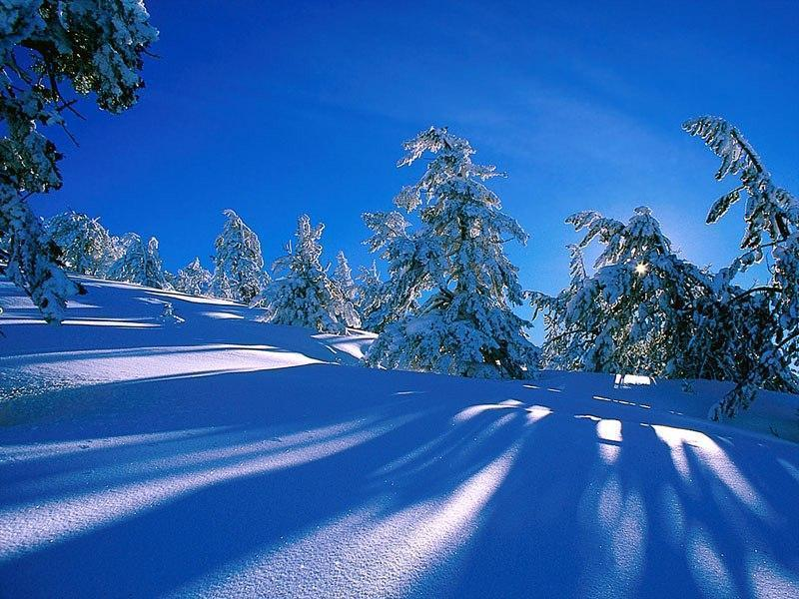
If you hold up your head with a smile on your face and are truly thankful ...
You are blessed because the majority can, but most do not.
www.richardtong.com.au

Slide 8
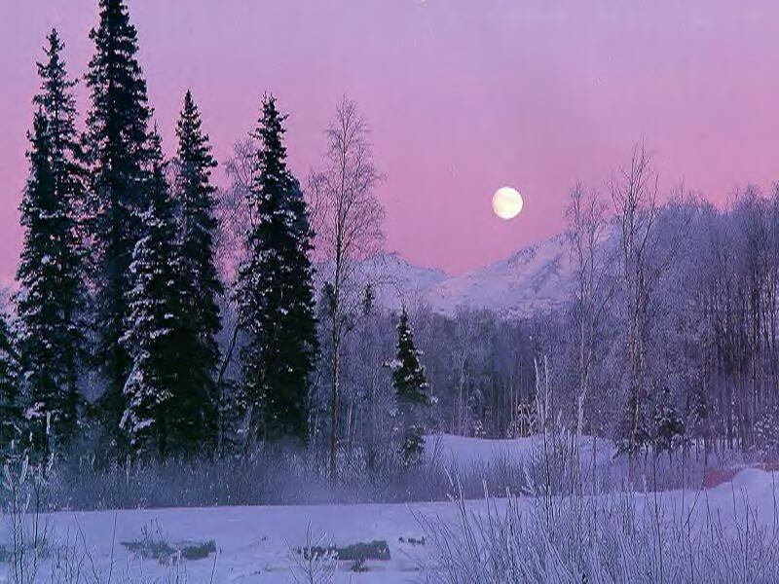
If you can hold someone's hand, hug them or even touch them on the shoulder ...
You are blessed because you can offer healing touch.
www.richardtong.com.au

Slide 9
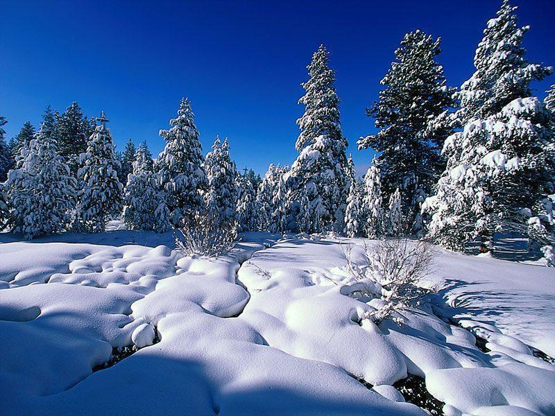
If you can read this message, you just received a double blessing that someone was thinking of you, and furthermore ...
You are more blessed than over two billion people in the world that cannot read at all.
www.richardtong.com.au

Slide 10
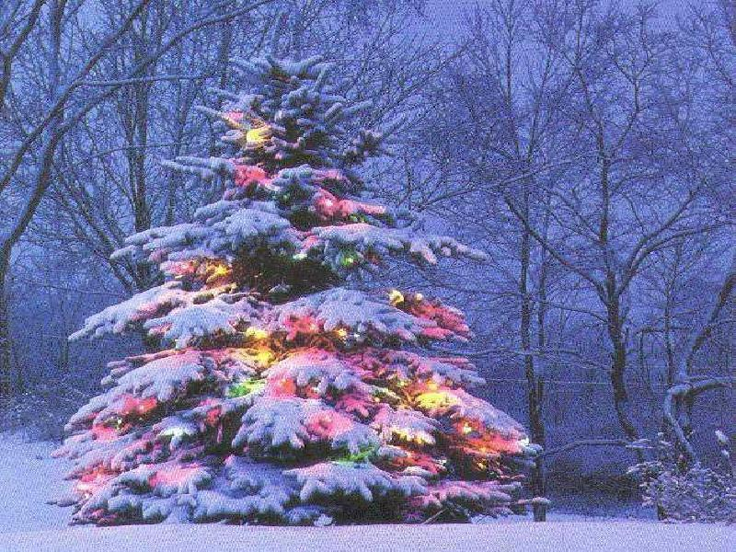
Have a good day, count your blessings,
and pass this along to remind everyone else
how blessed we all are.
You are wished a Merry Christmas
www.richardtong.com.au

